Slide 1
Language Solutions
Ankita Semwal-21104130
Shivani Zagade-21104021
Mrunal Shardul-21104037
Project Guide
Prof. Roshna Sangle

Slide 2
Contents
Introduction
Objectives
Scope
Features/Functionality
Project Outcomes
Technology Stack
Conclusion

Slide 3
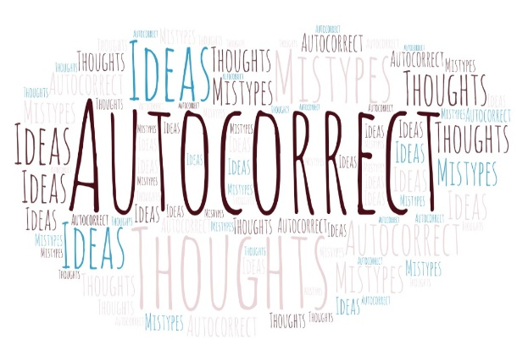
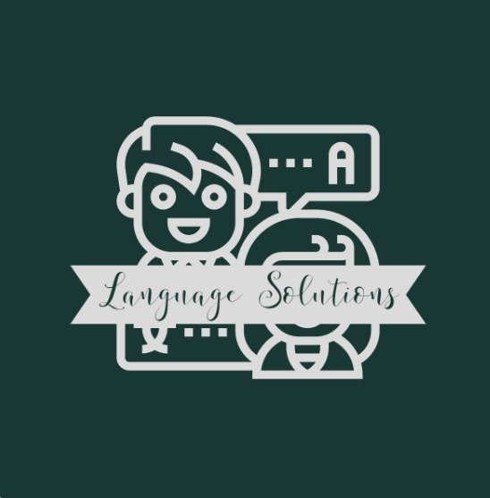
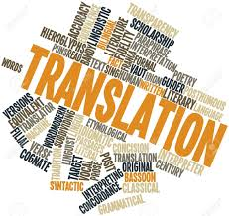
1.Introduction
Language Solutions-Helping people to translate ideas and thoughts, it is about developing a utility for users that is capable of translating the text into different languages and auto-correcting any mistakes made in the text
This utility will be beneficial for anyone who wants to communicate with people from different countries and cultures.
The utility will be able to support a variety of languages from around the world, allowing users to communicate with each other in the languages of their choice.

Slide 4
1.Introduction
We often come across many spelling mistakes while writing our texts. Auto corrector is very useful for people who want to ensure that there are no spelling errors in their texts.
As we all know a dictionary is an essential tool for anyone looking to expand their vocabulary. Talking dictionary helps people who are not familiar with some words or their definitions.
The utility will be very useful for people learning a new language who want to ensure their writing is error-free and those who have a keen interest in learning new words and their meanings.
Our platform also includes a word game that users may create and text-to-speech features. You can put your vocabulary skills to the test by contributing new terms to our platform's dictionary. The text-to-speech feature allows you to hear the correct pronunciation of words and phrases in a variety of languages.

Slide 5
2.Objectives of the project
To provide accurate translations of text from one language to another.
To identify and correct spelling and grammar mistakes made by the user while typing, so that the text is easier to read and understand.
To be designed with the aim of providing a user-friendly, regardless of their level of technical knowledge.
To have a platform that provides language learners improve vocabulary and spelling.
To save time by correcting spelling and translating text.
To provide users with a fun and engaging way to improve their language skills. It challenges users to form words from a set of letters or guess words from clues, helping them to expand their vocabulary and improve their spelling and grammar
To assist users who have difficulty reading or are visually impaired. It converts written text into speech, allowing users to listen to written content instead of reading it. This feature enhances accessibility and enables users to consume content in a more convenient and efficient way.

Slide 6
3.Scope of our project
Can help users learn a new language by providing accurate translations and correcting their mistakes.
Can be especially useful for people who are not native speakers of the language they are writing in.
Can help ensure that the content is accurately translated and free of errors, making it easier for people to access and understand the information.
Can Provide accurate definitions and additional features to help users search for definitions in real-time
Can help users develop their language and spelling skills by providing guidance and tools to help them construct and predict words.
Can help users translate written text into spoken words.
Can help individuals with visual impairments or reading challenges, as well as language learners who want to hear the correct pronunciation of words and phrases.

Slide 7
4.Features/Functionality
The utility will be able to provide users with accurate translations of the text into different languages.
It will also be able to auto-correct any mistakes made in the text. The utility will also be able to support a variety of languages from around the world.
It will also help reduce the amount of time spent correcting mistakes in the text.
The design of it will be modern, with a focus on simplicity and ease of use. All features will be easy to find and use
The system will allow users to look up definitions of words they are unsure of or unfamiliar with.
The system features a word game that allows users to exercise and increase their vocabulary in several languages.
This feature can make learning new words and phrases more enjoyable and engaging.
The Feature can help users listen to the translated text or the definition of a word using the system's text-to-speech capability. This function can be beneficial for people who have difficulties reading or pronouncing words in another language.

Slide 8
5. Project outcomes
To provide users with a powerful tool to help them communicate in multiple languages and auto-correct mistakes.
To reduce the time and effort needed to communicate in different languages and will help users become more proficient in their use of language.
To allow users to learn new words and phrases, expanding their vocabulary and improving their language skills.
To save time for users in terms of language translation, spell checking, and dictionary search, making their work more efficient.
To help users boost up their language skills and expand their vocabulary.
To help users who have difficulty in reading, allowing them to listen to the translated or correct text.

Slide 9
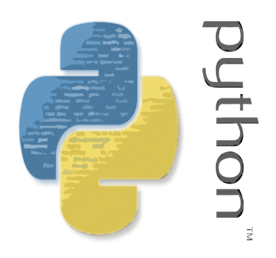


6. Technology Stack
Python
PyCharm IDE
Tkinter

Slide 10
7. Conclusion
This project is about developing a utility that is capable of translating the text into different languages and auto-correcting any mistakes made in the text.
Translation and auto-correcting tools have greatly improved communication and reduced errors in writing, making them essential tools for modern communication.
The project can save users time and effort, especially when dealing with multilingual communication or writing tasks.
It can also help users expand their vocabulary and improve their language skills by providing definitions of words they may not be familiar with.
Word game feature adds an element of fun and engagement, making it easier for users to learn new words and phrases.
The text-to-speech feature will allow users to listen to their text and make necessary edits, improving the accuracy and clarity of their writing.

Slide 11
Thank you !!

